Slide 1
Applied Data Science Capstone
By Raman Ratnakar

Slide 2
Report on ‘Opening a new restaurants’
Introduction:
Hadapsar is industrial area in the east south of Pune, India.
Around 10k people are living.
5k-6k are working professional
Need quality restaurant so that people can have quality food.

Slide 3
Business Problem:
Is it profitable to open new restaurant?
How many restaurants is there around Hadapsar, Pune?
Analytic Approach:
Based on the count of restaurants and food courts we can predicts the chances of opening a new restaurants and food courts in this locality.

Slide 4
Data:
I will use the below data from Foursquare API.
Number of restaurant and food court data around Hadapsar, Pune.
Location data of restaurant around Hadapsar, Pune.

Slide 5
Methodology:
Statistical testing based on the count of restaurant and food court to predict the possibility of opening a new restaurant

Slide 6
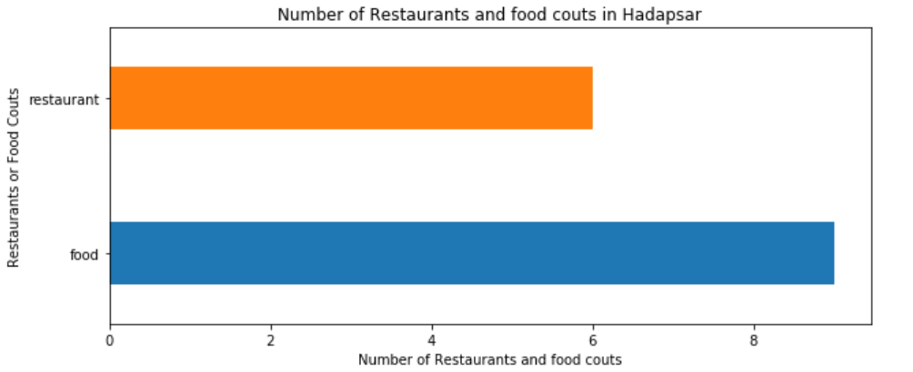
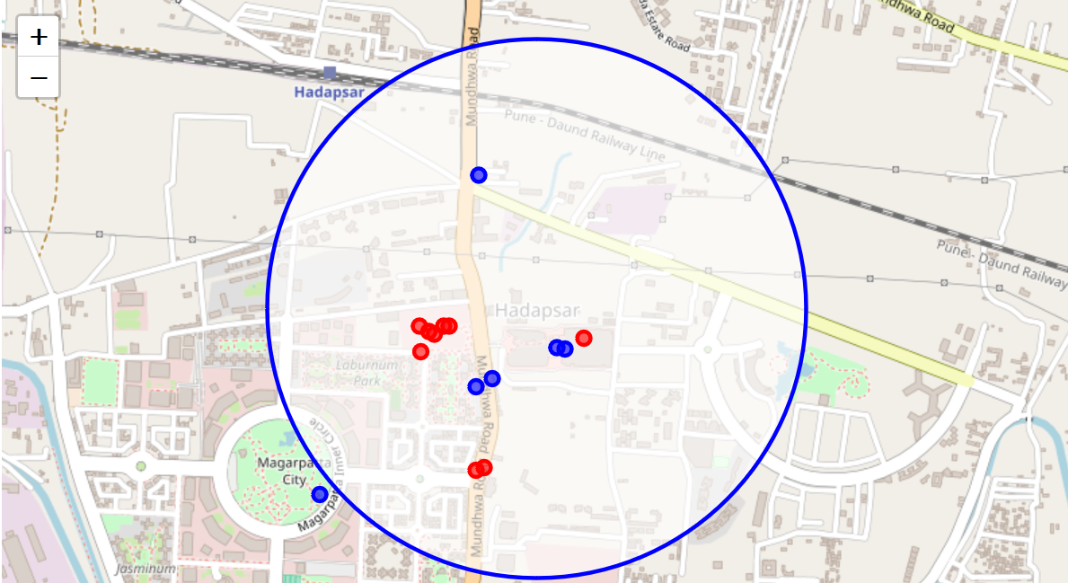
Result:
Number of restaurant and food court in Hadapsar, Pune

Slide 7
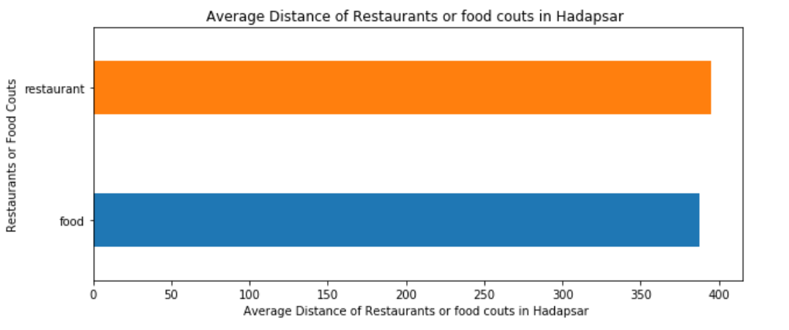
Average of distance of each restaurant near from Convent Garden London

Slide 8
Conclusion:
For a place where we have 10k people and most of them are working professional we need more restaurant, coffee shop, bars so that people can go and enjoy good food with their team and friends. From the data we get we can open new restaurant in this area and we believe that it will be profitable

